Slide 1

Introducing Computation Graphs
Hrisheekesh R Senior Data Analyst, Attinad Software
www.attinadsoftware.com

Slide 2

Overview
Model nodes, edges and dependencies in a computation graph
Understand the basic parts of a program in TensorFlow
Run TensorFlow programs and visualize results using TensorBoard

Slide 3

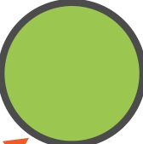

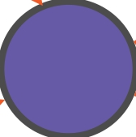


Tensors Flow Through the Graph
…and gets transformed along the way

Slide 4






Tensors Flow Through the Graph
A
Round
x
+ +
B floor abs
TensorFlow

Slide 5






Tensors Flow Through the Graph
A round x
+ +
B
floor
= (round(A)
abs
floor(B))
Y
+
*
round(A) + abs(round(A) + floor(B))

Slide 6
Directed-acyclic Graph
round x
+ +
floor abs

Slide 7






Directed-acyclic Graph
round x
+ +
floor abs
Edges point forward towards a result i.e. directed

Slide 8



Dependencies
round
x
+
One node can send its output to multiple nodes

Slide 9

Dependencies
round
+
floor
Or receive inputs from multiple nodes

Slide 10
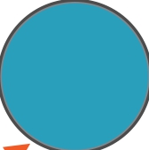



Dependencies
Direct
dependency
x
+
Indirect
dependency
+
floor

Slide 11



Directed-acyclic Graph
round
x
+ +
floor abs
There are no cycles in the graph i.e. acyclic

Slide 12
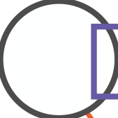
Directed-acyclic Graph
round
x
+ +
floor abs
A graph with cycles will never finish computation

Slide 13
Problems in TensorFlow are
represented as a directed-
acyclic graph

Slide 14
Cyclical Dependencies in Machine Learning

Slide 15
Directed-Acyclic Graph
round x
+ +
floor abs
A graph with cycles will never finish computation

Slide 16

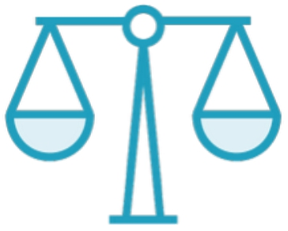
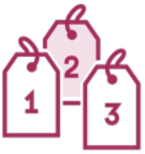
The Process of Machine Learning
Corpus of
data
Feature Selection & ML
Result

Slide 17
The Process of Machine Learning
Calculate loss
Feedback

Slide 18




The Process of Machine Learning
…

Slide 19





Modelling Cyclical Dependencies

Slide 20








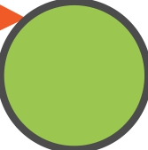

Modelling Cyclical Dependencies
Unrolling the graph

Slide 21















Modelling Cyclical Dependencies
Unrolling the graph

Slide 22




Modelling Cyclical Dependencies
How much you unroll depends on the
number of iterations you want to run

Slide 23
Unroll graphs to model cyclic
dependencies

Slide 24
Building and Running Graphs

Slide 25


2 Steps in a TensorFlow Program
Building a Graph
Specify the operations and
the data
Running a Graph
Execute the graph to get the
final result

Slide 26

Demo
Building and running a graph in TensorFlow
Exploring the graph using TensorBoard

Slide 27

2 Steps in a TensorFlow Program
Building a Graph
Specify the operations and
the data
Running a Graph
Execute the graph to get the
final result

Slide 28

2 Steps in a TensorFlow Program
Building a Graph
Specify the operations and
the data
Running a Graph
Execute the graph to get the
final result

Slide 29
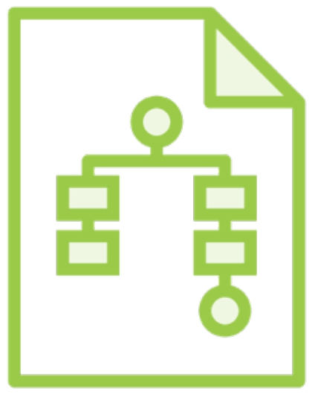
Visualizing a Graph
TensorBoard
Visualize how data flows and
what computations operate on it

Slide 30
Modeling Computations as Graphs

Slide 31


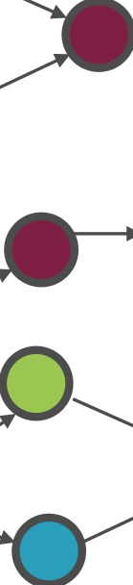
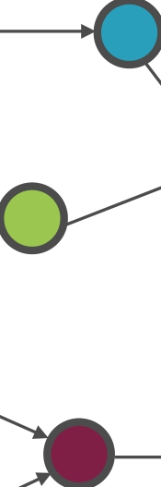
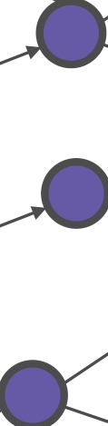


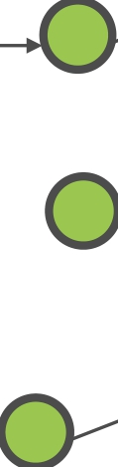
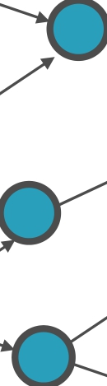




Computation Graphs

Slide 32
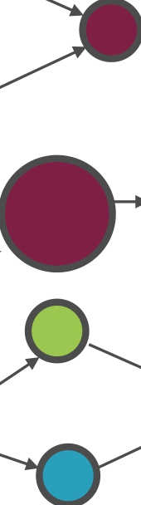

Computation Graphs

Slide 33




Computation Graphs

Slide 34
Computation Graphs

Slide 35
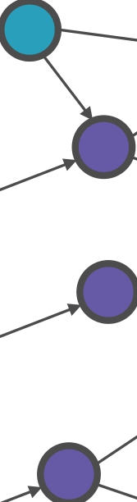
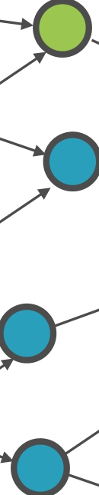
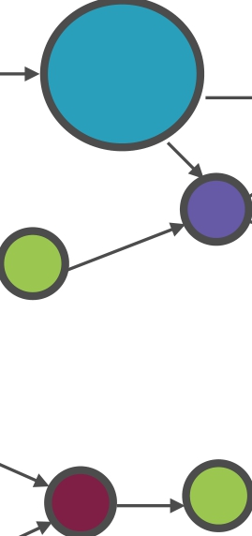
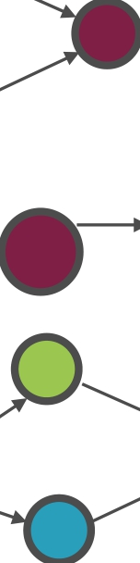
Computation Graphs

Slide 36







Computation Graphs

Slide 37
Computation Graphs

Slide 38
TensorFlow calculates only that
portion of the graph which is
required

Slide 39
Computation Graphs

Slide 40
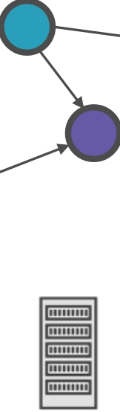
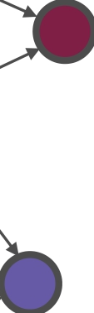

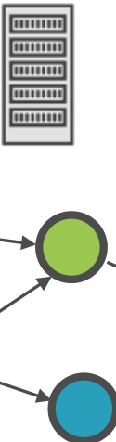



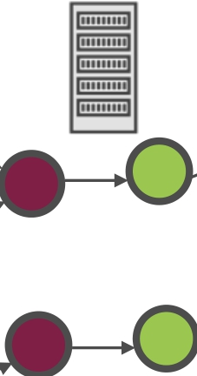












Running Graphs on a Distributed System

Slide 41
Multiple portions of the graph
can be run in parallel across
machines in the cluster

Slide 42
Demo
Executing simple math commands in TensorFlow
Notes:
simplemath.py

Slide 43
Tensors

Slide 44
Tensor
The central unit of data in TensorFlow. A tensor consists of a set of primitive values shaped into an array of any number of dimensions.
https://www.tensorflow.org/

Slide 45
Tensor
The central unit of data in TensorFlow. A tensor consists of a set of primitive values shaped into an array of any number of dimensions.
https://www.tensorflow.org/

Slide 46
Tensor
The central unit of data in TensorFlow. A tensor consists of a set of primitive values shaped into an array of any number of dimensions.
https://www.tensorflow.org/

Slide 47
Data Is Represented as Tensors
Scalars are 0-D tensors
3, 6.7, “a”

Slide 48
Data Is Represented as Tensors
Vectors are 1-D tensors
[1, 3, 5, 7, 9]

Slide 49
Data Is Represented as Tensors
Matrices are 2-D tensors
[[1, 3, 5],
[7, 9, 11]]

Slide 50
Data Is Represented as Tensors
N-Dimensional matrices are N-D tensors
[[[1, 2], [3, 4], [5, 6]], [[7, 8], [9, 10], [11, 12]]]

Slide 51
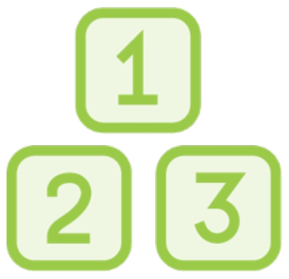


Characterization of Tensors
Rank
The number of
dimensions in a tensor
Shape
The number of elements
in each dimension
Data Type
The data type of each element in the tensor

Slide 52
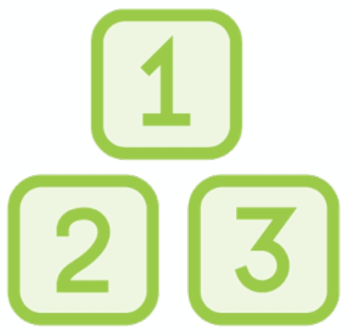
Rank
Tensor | Rank
4 | 0
[1, 2, 3] | 1
[[1, 2], [3, 4]] | 2
[[[1], [2]], [[3], [4]]] | 3

Slide 53

Shape
Tensor | Shape
4 | []
[1, 2, 3] | [3]
[[1, 2, 3], [4, 5, 6]] | [3, 2]
[[[1], [2]], [[3], [4]]] | [2, 2, 1]

Slide 54

Data Type
int
float
string

Slide 55
Rank, shape and data types are
3 important characteristics
which define a Tensor

Slide 56
Demo
Use tf.rank() to know the rank of Tensors

Slide 57
Demo
Execute the simple math program with Tensors rather than scalar inputs

Slide 58
Demo Use numpy arrays in TensorFlow

Slide 59
Worked with the directed-acyclic graph to model problems in TensorFlow
Understood constants, operators and sessions
Understood Tensor characteristics such as rank, shape and data type
Run TensorFlow programs and visualized results using TensorBoard
Summary

